Slide 1
JWS(rfc7515) vs XMLDsig
106th OGC Technical Committee
Orléans, France
Frank Terpstra
20 March 2018

Slide 2
Why?
I suggested CityJSON do signatures
https://github.com/tudelft3d/cityjson/issues/11
I therefor researched the use of JWS(rfc7515)

Slide 3
XMLDSIG vs JWS overview
sources:
https://www.di-mgt.com.au/xmldsig2.html
https://community.apigee.com/articles/21711/dsig-part-3-xml-dsig-vs-json-web-signature.html
https://medium.facilelogin.com/json-message-signing-alternatives-897f90d411c
Enveloping signature VS enveloped signature
Canonicalization
conclusion

Slide 4
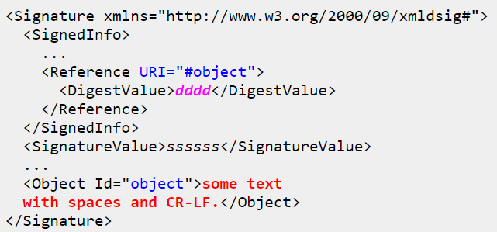
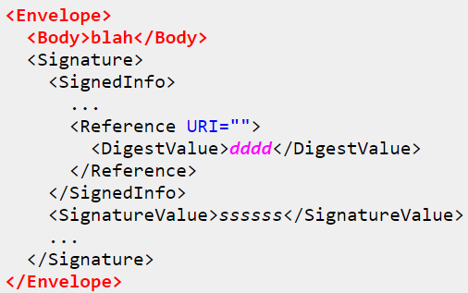
XML Enveloping VS enveloped signature

Slide 5
JWS is enveloping only
JWS allows for two forms of serialization:
Compact serialization & JSON serialization
Compact serialization:
BASE64URL(UTF8(JWS Protected Header)) || '.' ||
BASE64URL(JWS Payload) || '.' ||
BASE64URL(JWS Signature)
Example:
eyJ0eXAiOiJKV1QiLA0KICJhbGciOiJIUzI1NiJ9
.
eyJpc3MiOiJqb2UiLA0KICJleHAiOjEzMDA4MTkzODAsDQogImh0dHA6Ly9leGFt
cGxlLmNvbS9pc19yb290Ijp0cnVlfQ
.
dBjftJeZ4CVP-mB92K27uhbUJU1p1r_wW1gFWFOEjXk

Slide 6
JWS is enveloping only
JSON serialization (allows multiple signatures)
{
"payload":
"eyJpc3MiOiJqb2UiLA0KICJleHAiOjEzMDA4MTkzODAsDQogImh0dHA6Ly9leGF
tcGxlLmNvbS9pc19yb290Ijp0cnVlfQ",
"signatures":[
{"protected":"eyJhbGciOiJSUzI1NiJ9",
"header":
{"kid":"2010-12-29"},
"signature":
"cC4hiUPoj9Eetdgtv3hF80EGrhuB__dzERat0XF9g2VtQgr9PJbu3XOiZj5RZ
mh7AAuHIm4Bh-0Qc_lF5YKt_O8W2Fp5jujGbds9uJdbF9CUAr7t1dnZcAcQjb
KBYNX4BAynRFdiuB--f_nZLgrnbyTyWzO75vRK5h6xBArLIARNPvkSjtQBMHl
b1L07Qe7K0GarZRmB_eSN9383LcOLn6_dO--xi12jzDwusC-eOkHWEsqtFZES
c6BfI7noOPqvhJ1phCnvWh6IeYI2w9QOYEUipUTI8np6LbgGY9Fs98rqVt5AX
LIhWkWywlVmtVrBp0igcN_IoypGlUPQGe77Rw"},
{"protected":"eyJhbGciOiJFUzI1NiJ9",
"header":
{"kid":"e9bc097a-ce51-4036-9562-d2ade882db0d"},
"signature":
"DtEhU3ljbEg8L38VWAfUAqOyKAM6-Xx-F4GawxaepmXFCgfTjDxw5djxLa8IS
lSApmWQxfKTUJqPP3-Kg6NU1Q"}]
}

Slide 7
Enveloped JSON alternative?
https://cyberphone.github.io/doc/security/jcs.html
Not really a standard, few implementations available.
Example:
{ "now": "2017-04-16T11:23:06Z", "escapeMe": "\u20ac$\u000F\u000aA'\u0042\u0022\u005c\\\"\/", "numbers": [1e+30,4.5,6], "signature": { "algorithm": "ES256", "publicKey": { "kty": "EC", "crv": "P-256", "x": "_gow8fcS3Dx9z6j57U5q8tunnRBdrgLU9A7CZTYCnqU", "y": "bdfJGraBVL5aPj38TG4tHwxpU2VKwG1XBp0wQfCLOFQ" }, "value": "aRx2MQyCGVOZGViAC_7bEDUp8_CGO1kU1l7Lvp1FHx4qBiPkGs9Z7TKGK774XLTGwaCfUtd1VrscabQhmArCxA" } }

Slide 8
XML DSIG DigestValue
Before computing digest first canonicalize
Remove the xml declaration (<?xml...).
Start at precisely the "<" character opening the root element (<Envelope>) and end at the ">" character that closes this element (</Envelope>).
Retain all whitespace between these "<" and ">" characters.
Encode in UTF-8.
Replace all CR-LF line endings with the newline character 0x0A.
Remove the Signature element but leave any surrounding whitespace intact.
Or see https://www.di-mgt.com.au/xmldsig-c14n.html for the real harsh nitty gritty truth
Compute digest and encode digest using Base64 encoding
Place base64 encoded value between <DigestValue> tags in <SignatureInfo>

Slide 9
JWS avoids canonicalization
From the Spec:
JWS represents digitally signed or MACed content using JSON data structures and base64url encoding. These JSON data structures MAY contain whitespace and/or line breaks before or after any JSON values or structural characters, in accordance with Section 2 of RFC 7159 [RFC7159]
This means that :
{
'a':'b',
'c':'d’
}
And
{ 'a':'b', 'c':’d’}
Are supposed to be interpreted as being equal by a JSON parser, yet their UTF-8 representation (used as a basis for the signing) differs

Slide 10
JWS avoids canonicalization
According to JWS spec you should validate signatures based on the UTF8 representation of JSON txt from the payload.
You cannot first give the payload to a JSON parser and then expect to validate the signature based on the result of the parser
You can sign basically anything it does not need to be JSON.

Slide 11
Conclusion
JWS is simpler and more efficient than XMLDsig
No JWS support for envoloped signatures
Current proposal for signatures in (OGC) XML uses enveloped signature
No similar approach possible (at this time) for JSON encodings
JWS theoretically supports signing XML payloads as an enveloping signature
Single simple approach possible? (probably not)

